Slide 1

Ancient Beliefs and Languages of Eurasian Nomads
Lecture #8

Slide 2
Animism
Shamanism
Manicheism
Zoroastrianism
Tengrianism
Cult of Ancestors

Slide 3
Tengrism/Tengrianism
Tengrism was the religion of of pastoral, semi-sedentarized khanates and empires from the Xiongnu Empire (founded 209 BC) to the Mongol Empire (13th century). Unlike Siberian shamanism, which has no written tradition, Tengrism can be identified from Turkic and Mongolic historical texts like the Orkhon inscriptions, Secret History of the Mongols, and Altan Tobchi. However, these texts are more historically oriented and are not strictly religious texts like the scriptures and sutras of sedentary civilizations, which have elaborate doctrines and religious stories.
There are 99 tengri, or sky spirits, and 33 gods, led by Qormusta Tengri, or the “King of the Gods” according Tengriism. He is the god of the sky, and uses the crow and fox as his agents. There are similar gods to Qormusta in Iranian folk religions and Indian religions.

Slide 4
shamanism
The term "shamanism" was first applied by Western anthropologists as outside observers of the ancient religion of the Turkic and Mongolic peoples, as well as those of the neighbouring Tungusic and Samoyedic-speaking peoples. Upon observing more religious traditions across the world, some Western anthropologists began to also use the term in a very broad sense. The term was used to describe unrelated magico-religious practices found within the ethnic religions of other parts of Asia, Africa, Australasia and even completely unrelated parts of the Americas, as they believed these practices to be similar to one another.

Slide 5
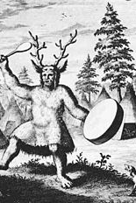
The earliest known depiction of a Siberian shaman, drawn by the Dutch explorer Nicolaes Witsen, who wrote an account of his travels among Samoyedic- and Tungusic-speaking peoples in 1692. Witsen labeled the illustration as a "Priest of the Devil", giving this figure clawed feet to express what he thought were demonic qualities

Slide 6
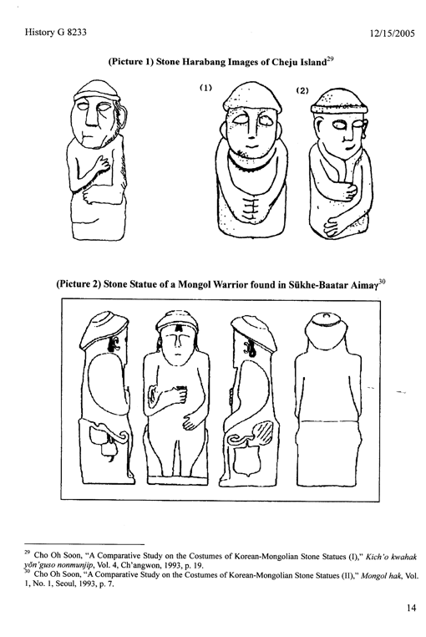
Stone Statues found on the Korean Island stemming from the era of Mongol Conquests

Slide 7
Manichaeism
Manichaeism is a formerly major world religion, founded in the 3rd century CE by the Parthian prophet Mani, in the Sasanian Empire. Manichaeism teaches an elaborate dualistic cosmology describing the struggle between a good, spiritual world of light, and an evil, material world of darkness.
According to Mani the First-Man now emanates sons as a man who puts on his armor for the combat. These five sons are the five elements opposed to the five aeons of darkness: Clear Air, Refreshing Wind, Bright Light, Life-Giving Waters, and Warming Fire.

Slide 8
Zoroastrianism
A monotheistic pre-Islamic religion of ancient Persia founded by Zoroaster in the 6th century BC.
Zoroastrianism is one of the world's oldest organized faiths. It has a dualistic cosmology of good and evil within the framework of a monotheistic ontology and an eschatology which predicts the ultimate conquest of evil by good.

Slide 9
Cult of Ancestors
The veneration of the dead, including one's ancestors, is based on love and respect for the deceased. In some cultures, it is related to beliefs that the dead have a continued existence, and may possess the ability to influence the fortune of the living. Some groups venerate their direct, familial ancestors.

Slide 10
Mahmud al-Kashgari (1029/1038 – 1101) –
an outstanding scientist, a philosopher of the XI century, and the author of the first dictionary of Turkic dialects “The Divan Lugat at Turk” based on a comparative analysis of dialects spoken by the Turkic-speaking tribes that inhabited the territory of Turkestan, which mostly comprised the territories of modern Kazakhstan located between the rivers of Irtysh and Syr Darya.

Slide 11
“Divan Lugat at Turk” (1072)
based on a comparative analysis of the materials used among the Turkic-speaking tribes that inhabited the territory of Turkestan, most of which was the territory of modern Kazakhstan from the Irtysh to the Syr Darya inclusive. The only copy of the manuscript is stored in Istanbul and consists of 1 volume (319 p.). The dictionary reflects the vocabulary of 31 Turkic dialects that were commonly spoken in the XI in the areas indicated above. The dictionary allows us to trace the development of the written Kipchak documents that accompanied the formation of the ethnic culture of the Turkic peoples.

